Slide 1


LinkedIn Engage: Generate Smart Comments on LinkedIn
LinkedIn Engage is a Chrome extension designed to elevate your LinkedIn engagement. It helps professionals like you generate thoughtful, context-aware comments quickly and easily. While the extension is primarily focused on healthcare content, it intelligently adapts to various professional topics including business, technology, and general professional development. Increase your visibility and build meaningful connections on LinkedIn using our extension.
by Piyush Kashyap

Slide 2




Multi-Industry Comment Generation
LinkedIn Engage is versatile, adapting to generate comments across several industries. Its primary expertise lies in healthcare-related content, providing insightful and HIPAA compliant responses. But it doesn't stop there; it also handles business and leadership topics, technology and innovation discussions, and general professional subjects with ease. Experience relevant and thoughtful engagement, no matter the topic.
Healthcare Focus
Business & Leadership
Technology & Innovation
Primary expertise in healthcare-related content.
Insightful comments on organizational strategies and professional development.
Comments on digital transformation and tech solutions.

Slide 3
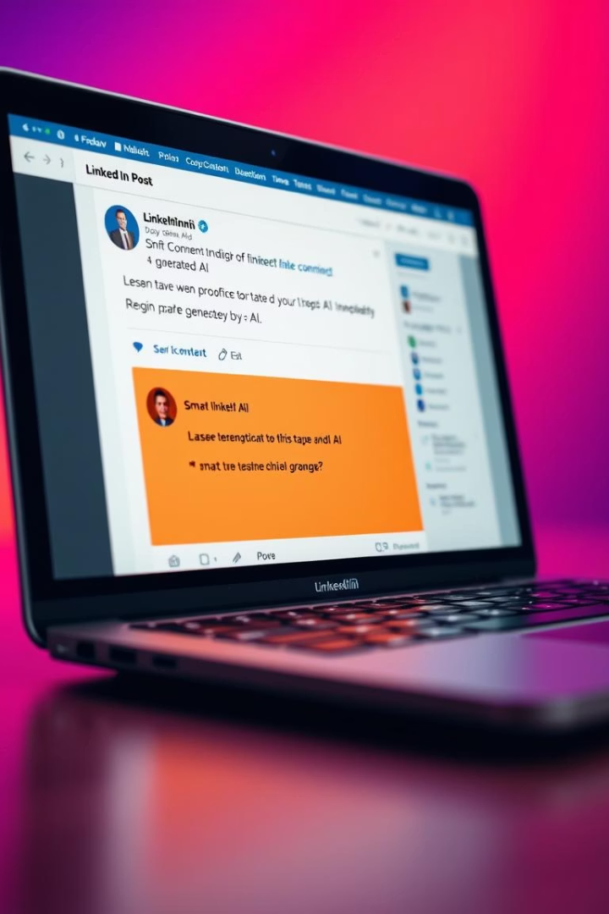



Smart Comment Generation: Context-Aware Responses
LinkedIn Engage doesn't just generate generic comments; it creates context-aware responses tailored to the specific post content. It offers industry-specific insights and perspectives, maintaining a professional tone at all times. The extension can even pose engagement-focused questions to further stimulate conversation. It adapts its expertise level based on the topic at hand, ensuring relevance and accuracy.
Context-Aware
Responses based on post content
Industry Insights
Specific perspectives
Professional Tone
Maintains professionalism

Slide 4
Ensuring Quality Control and Compliance
Quality is paramount. LinkedIn Engage includes robust quality control measures to ensure content relevance and maintain professional boundaries. The extension adapts its expertise level to match the topic and includes comprehensive error handling to prevent issues. For healthcare content, HIPAA compliance is strictly enforced, safeguarding sensitive information and protecting user privacy.
Content Relevance
Professional Boundaries
HIPAA Compliance
Verification of generated content.
Maintenance of appropriate conduct.
Ensuring privacy for healthcare.

Slide 5
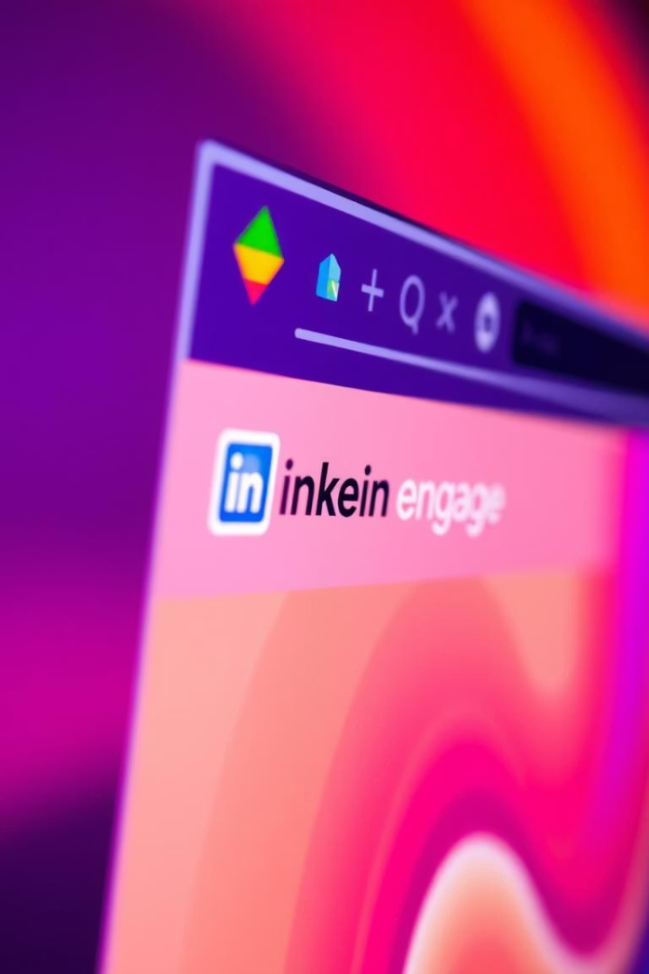



Seamless User Experience
LinkedIn Engage provides a seamless user experience, integrating directly into LinkedIn for one-click comment generation. Once a comment is generated, the extension automatically inserts it into the editor, saving you time and effort. Comprehensive error handling and recovery mechanisms are in place to prevent interruptions, and robust state management ensures smooth operation across multiple interactions.
Seamless Integration
One-Click Generation
Automatic Insertion

Slide 6

Technical Architecture: Backend (FastAPI)
The backend of LinkedIn Engage is built using FastAPI, a modern, high-performance web framework. API endpoints, such as /generate_comment, facilitate comment generation. Google's Gemini 1.5 Flash model is integrated for AI functionality, with custom prompt engineering tailored for different industries. Security measures include CORS middleware, environment variable management, and comprehensive error handling and logging.
API Endpoints
AI Integration
/generate_comment for comment generation
Gemini 1.5 Flash model
Security
CORS, env vars, error handling

Slide 7



Technical Architecture: Frontend (Chrome Extension)
The frontend is a Chrome extension featuring content scripts for post text extraction, comment button detection, and automatic comment insertion. It requests permissions for scripting and activeTab. State management tracks comment insertion and monitors API call status. This ensures a responsive and efficient user experience, with reliable interactions between the extension and the LinkedIn platform.
State Management
1
Status monitoring
Permissions
2
Scripting & activeTab
Content Scripts
3
Extraction & insertion

Slide 8

Simple Steps to Use LinkedIn Engage
Using LinkedIn Engage is straightforward. First, log in to your LinkedIn account and browse your feed. When you find a post you want to comment on, click the "Comment" button. The extension will automatically extract the post content, generate a context-aware comment, and insert it into the editor. Finally, review the generated comment, edit if necessary, and click "Post" to share your thoughtful response.
Navigate to LinkedIn
Log in and browse your feed.
Generate Comments
Click "Comment" to generate
Review and Post
Edit if needed and share.

